Slide 1

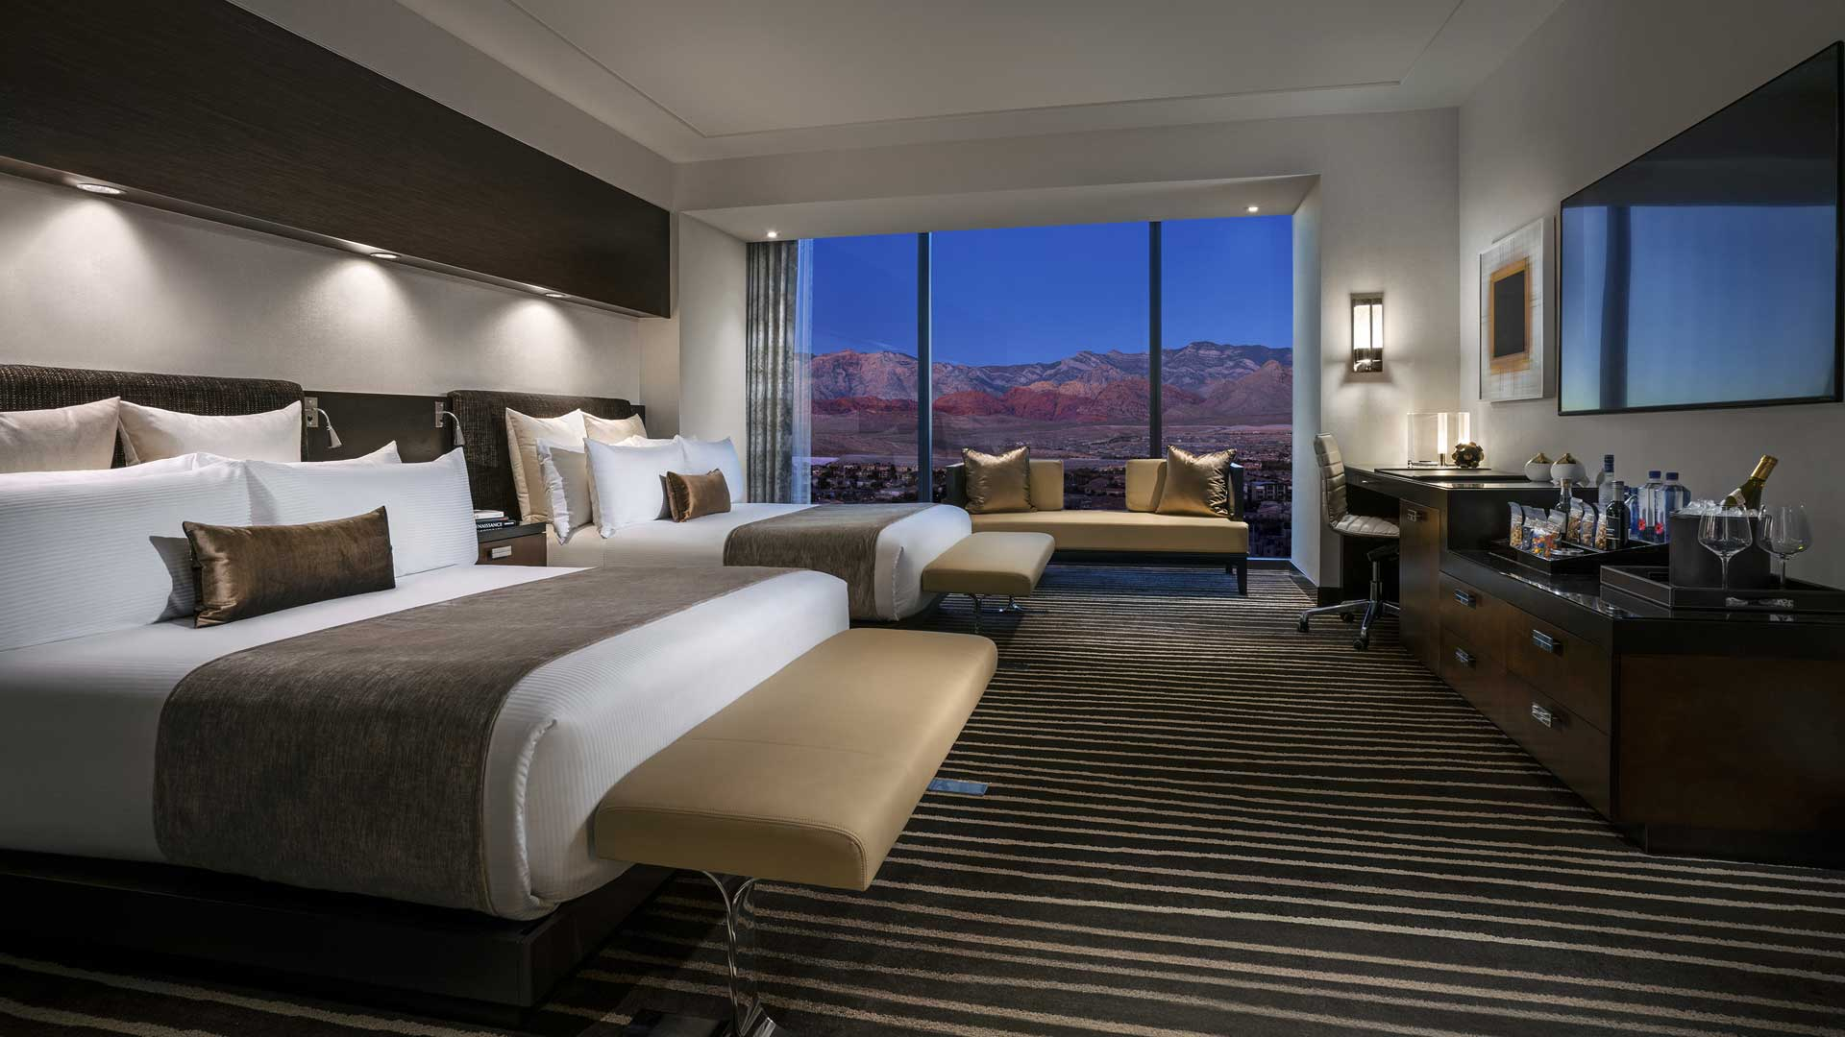
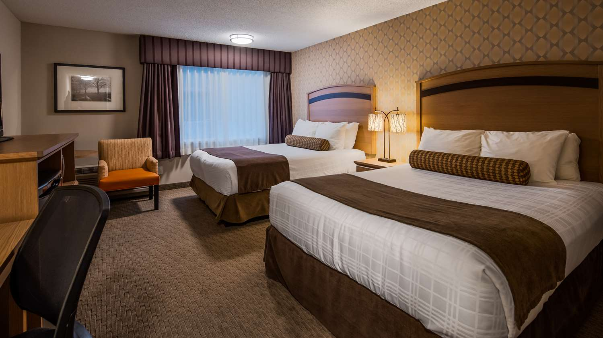
Hotel Reservation Analysis
Presented By
Ashok Kumar Kuruva

Slide 2
Overview :
The hotel industry relies on data to make informed decisions and provide a better guest experience. In this internship, you will work with a hotel reservation dataset to gain insights into guest preferences, booking trends, and other key factors that impact the hotel's operations. You will use SQL to query and analyze the data, as well as answer specific questions about the dataset.
Presented By
Ashok Kumar Kuruva

Slide 3
Dataset Details: The dataset includes the following columns:
Booking_ID: A unique identifier for each hotel reservation.
no_of_adults: The number of adults in the reservation.
no_of_children: The number of children in the reservation.
no_of_weekend_nights: The number of nights in the reservation that fall on weekends.
no_of_week_nights: The number of nights in the reservation that fall on weekdays.
type_of_meal_plan: The meal plan chosen by the guests.
room_type_reserved: The type of room reserved by the guests.
lead_time: The number of days between booking and arrival.
arrival_date: The date of arrival.
market_segment_type: The market segment to which the reservation belongs.
avg_price_per_room: The average price per room in the reservation.
booking_status: The status of the booking
Presented By
Ashok Kumar Kuruva

Slide 4
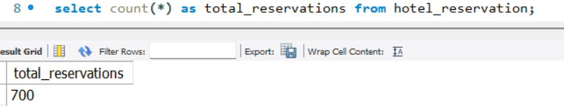
1. What is the total number of reservations in the dataset ?
Presented By
Ashok Kumar Kuruva

Slide 5
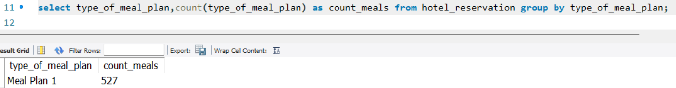
2. Which meal plan is the most popular among guests?
Presented By
Ashok Kumar Kuruva

Slide 6
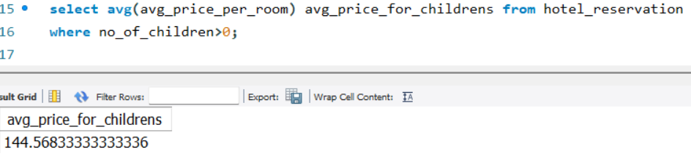
3. What is the average price per room for reservations involving children?
Presented By
Ashok Kumar Kuruva

Slide 7
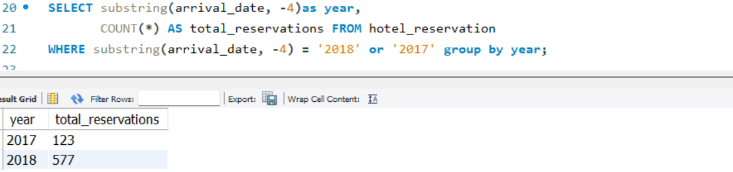
4. How many reservations were made for the year 20XX (replace XX with the desired year)?
Presented By
Ashok Kumar Kuruva

Slide 8
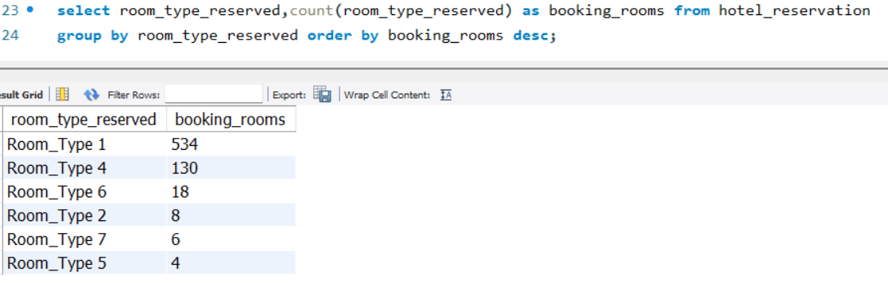
5. What is the most commonly booked room type?
Presented By
Ashok Kumar Kuruva

Slide 9
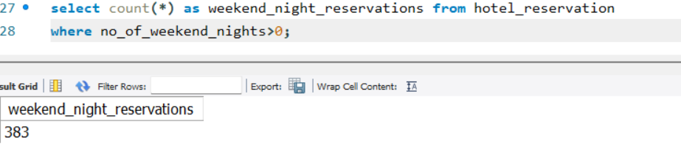
6. How many reservations fall on a weekend (no_of_weekend_nights > 0)?
Presented By
Ashok Kumar Kuruva

Slide 10
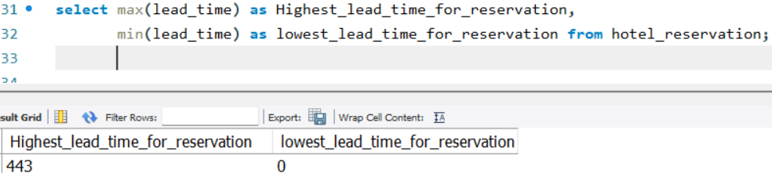
7. What is the highest and lowest lead time for reservations?
Presented By
Ashok Kumar Kuruva

Slide 11
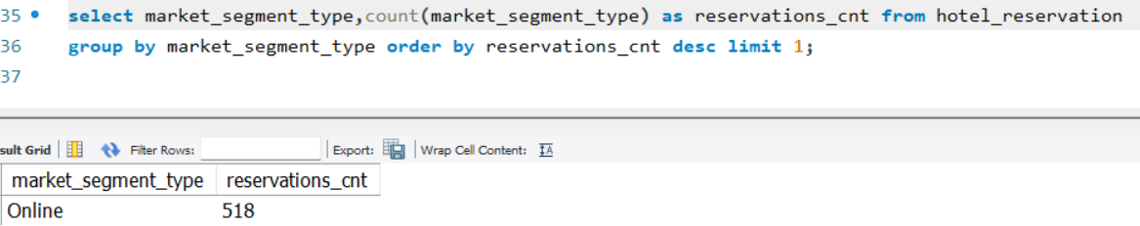
8. What is the most common market segment type for reservations?
Presented By
Ashok Kumar Kuruva

Slide 12
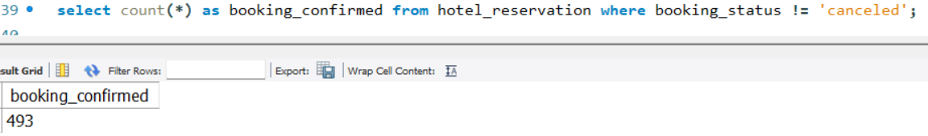
9. How many reservations have a booking status of "Confirmed"?
Presented By
Ashok Kumar Kuruva

Slide 13
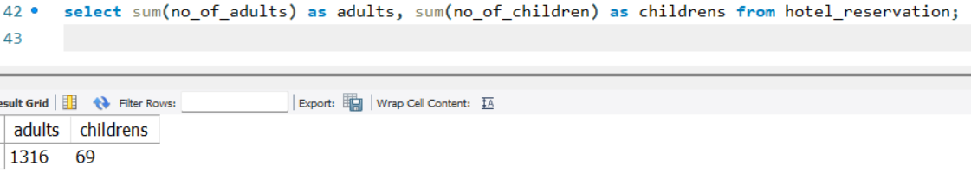
10. What is the total number of adults and children across all reservations?
Presented By
Ashok Kumar Kuruva

Slide 14
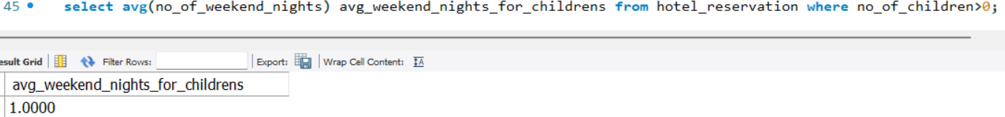
11. What is the average number of weekend nights for reservations involving children?
Presented By
Ashok Kumar Kuruva

Slide 15
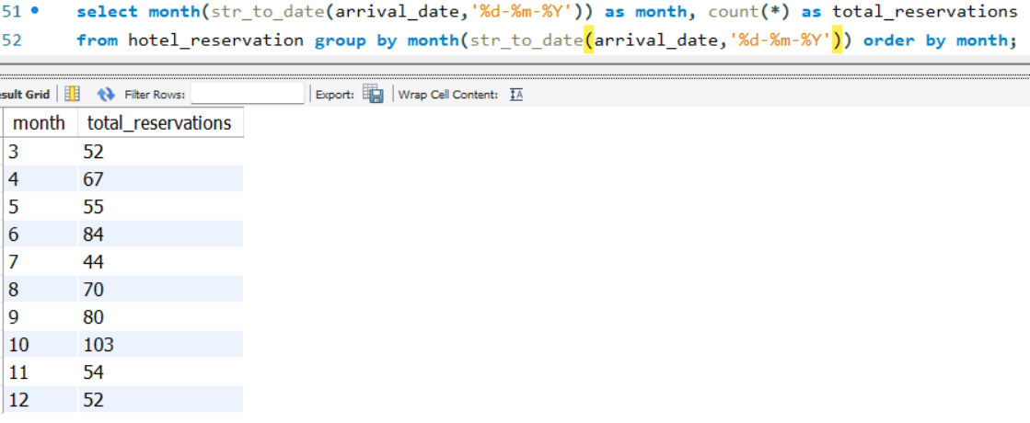
12. How many reservations were made in each month of the year?
Presented By
Ashok Kumar Kuruva

Slide 16
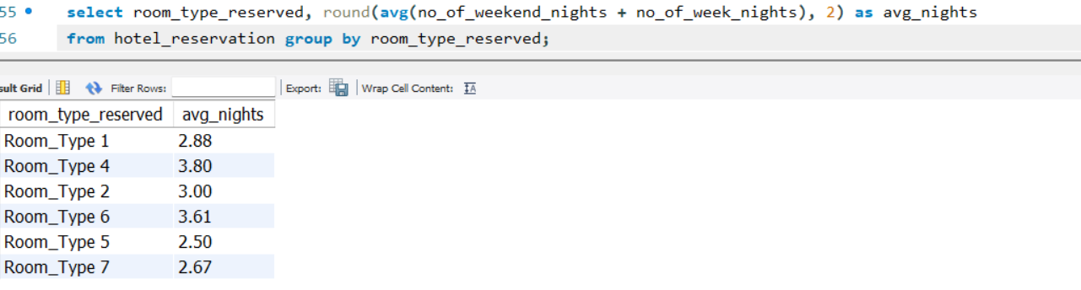
13. What is the average number of nights (both weekend and weekday) spent by guests for each room type?
Presented By
Ashok Kumar Kuruva

Slide 17
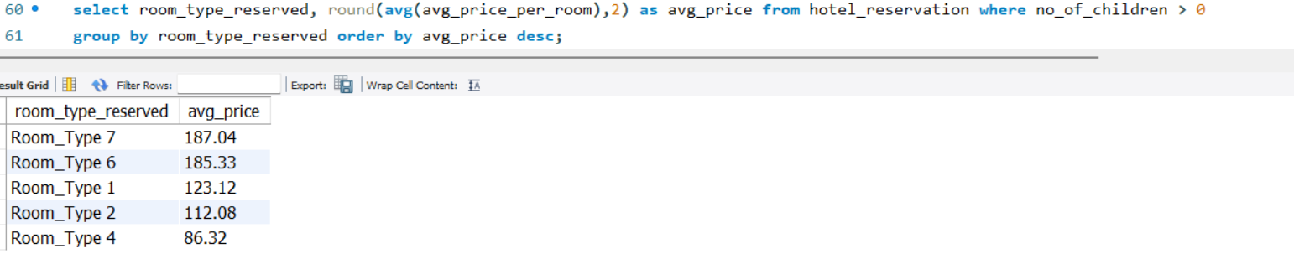
14. For reservations involving children, what is the most common room type, and what is the average price for that room type?
Presented By
Ashok Kumar Kuruva

Slide 18
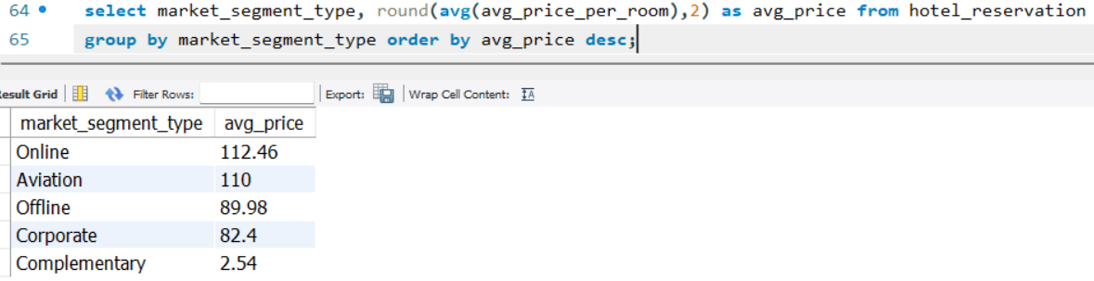
15. Find the market segment type that generates the highest average price per room.
Presented By
Ashok Kumar Kuruva

Slide 19


